Slide 1



S.M.S
Smart Mirror System
Deajeon Univ. Linc 3.0 Industrial Parks
Younghoon Yoon
Deajeon Univ. Computer Science
Honggyo Lee, Hamin im

Slide 2
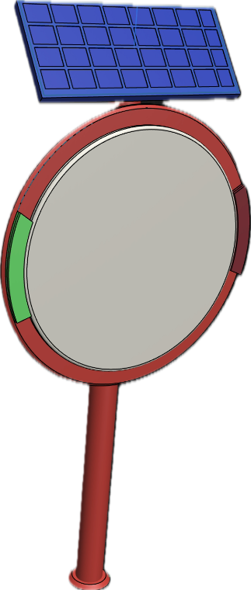
Contents
Introduction
• Who participated in the project?
• What is S.M.S?
Objective
• What can it be used for?
• What are the technologies?
• Future technologies to be added

Slide 3




Introduction
• Who participated in the project?
Honggyo Lee
Hamin Im
Deajeon Univ. Computer Science
GDSC Deajeon Univ. Member
3rd place in 2022 Metaverse Developer Contest
3rd place in 2023 Daejeon Youth Social Startup Hackathon
https://github.com/LeeHongyo
2_hong_gyo
Deajeon Univ. Computer Science
Republic of Korea Air Force Sgt. Discharged
Winning the 'Best Innovation Award' at the e-ICON World Competition
3rd place in 2023 Daejeon Youth Social Startup Hackathon
https://github.com/limhamin
be_ta_min

Slide 4
Introduction
• What is S.M.S?
The Smart Mirror System is an item that aims to reduce accidents by detecting “blind spots”, the biggest risk factors on the road, to ensure the safety of cars, motorcycles, and pedestrians.

Slide 5





Objective
• What can it be used for?
It can be used to prevent accidents around the river
Alerts car and
motorcycle drivers in traffic blind spots
Makes walking safer for pedestrians

Slide 6
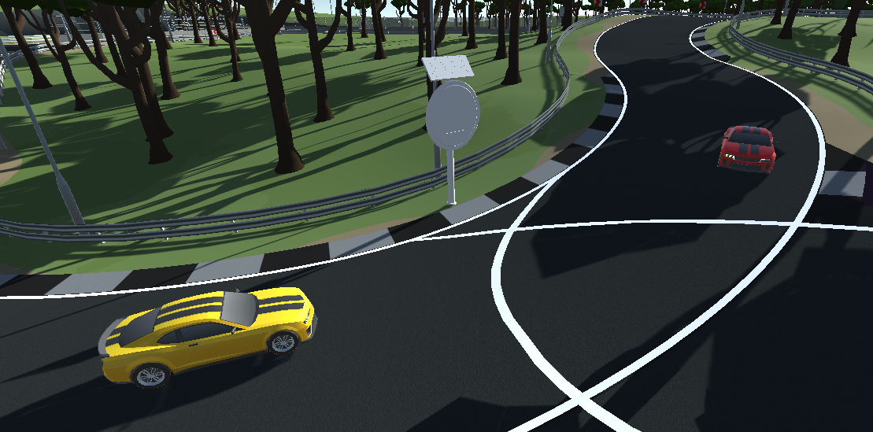
Objective
• What are the technologies?
1. Ensure pedestrians and motorcycles enter via radar sensors
2. Sends the radar sensor value to the processing unit of the S.M.S.
3. The S.M.S. sends an LED signal.
4. LED tell pedestrians and drivers to be careful.

Slide 7
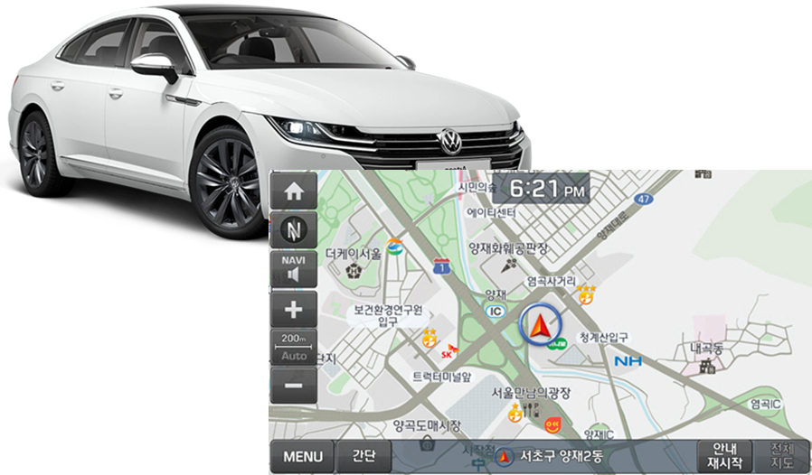
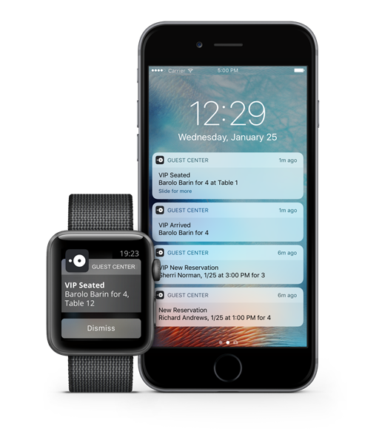
Objective
• Future technologies to be added
Car navigation (Uber, Grab etc.), direct notification by communicating with personal cell phone
You can pay more attention to safety by directly notifying drivers and pedestrians.

Slide 8
Thank you

